Slide 1

Implementation of Socially Responsible Licensing Principles
Bryce Pilz
Assistant Vice President for Research -
Licensing & Strategic Alliances

Slide 2
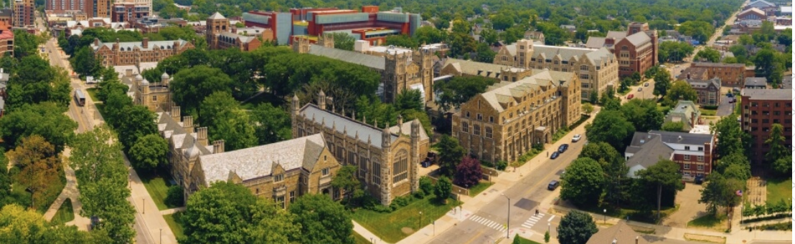
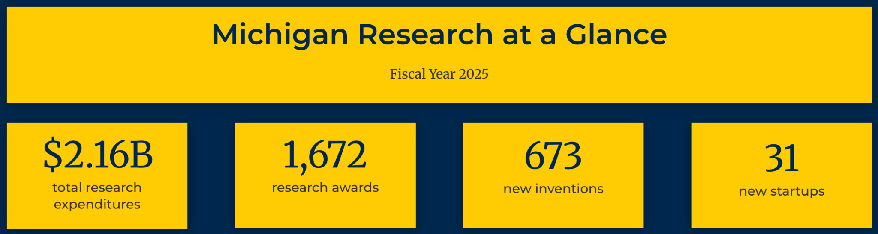

Slide 3


IT’S OUR JOB TO MAKE SURE THAT EVERY U-M RESEARCH DISCOVERY HAS AN OPPORTUNITY TO CHANGE THE WORLD.
MAXIMIZE POSITIVE SOCIETAL IMPACT

Slide 4
AUTM’S NINE POINTS FOR LICENSING IN THE PUBLIC INTEREST
Background
Origin: Principles to ensure licensing in socially responsible manner(adopted 2007)
Adoption: 120+ institutions signed on, including Fundación Universidad del Norte and Cambiotec AC
Other Models: Netherlands Federation of University Medical Centers and others have adopted similar principles
Reserve research rights
Diligence milestones to encourage development & use
Limit licensing future improvements
Identify and manage conflicts of interest
Broad access to research tools
Carefully consider enforcement
Be mindful of export regulations
Be mindful of patent aggregators
Consider unmet needs provisions
Principles to ensure licensing in socially responsible manner(adopted 2007)
120+ institutions signed on, including Fundación Universidad del Norte and Cambiotec AC
Netherlands Federation of University Medical Centers and others have adopted similar principles

Slide 5
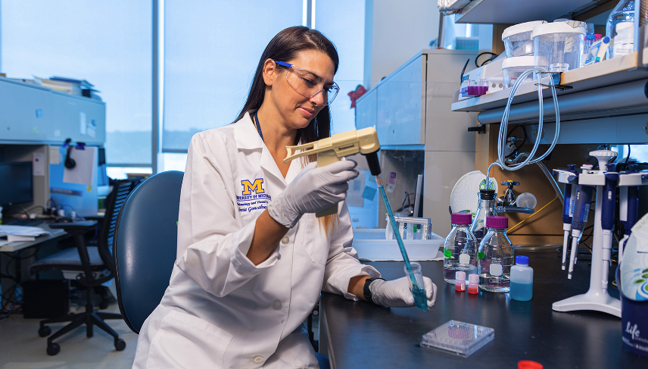
#1 RESEARCH RIGHTS
Context
Standard Position: Institutional research must remain unfettered by commercial exclusivity.
Necessary: There is no “fair use” right for patents, so a licensor must explicitly reserve this right in an exclusive license.
Negotiations: Can be heavily negotiated especially in life sciences.
Point 1
Universities should reserve the right to practice licensed inventions and to allow other non-profit and governmental organizations to do so.

Slide 6
U-M’S RESERVED RESEARCH RIGHTS
Common Issues
Common Request: Limit ability to perform industry funded research.
inventor consent required
Common Request: Limit “clinical” research.
inventor consent required & restriction limited to inventor’s lab
Common Request: Limit ability to grant rights to others.
will agree to notify licensee
ARTICLE 2: GRANT OF RIGHTS
2.1 MICHIGAN hereby grants to LICENSEE an exclusive license under the PATENT RIGHTS, with the right to grant sublicenses, both subject to the terms and conditions of this Agreement, in the FIELD OF USE and the TERRITORY to make, have made, import, use, market, offer for sale and sell LICENSED PRODUCTS.
2.2 Without limiting any other rights it may have, MICHIGAN specifically reserves the right for it and its AFFILIATES to practice and have practiced the PATENT RIGHTS for research, public service, internal (including clinical) and/or educational purposes, and the right to grant the same limited rights to other non-profit research institutions.

Slide 7
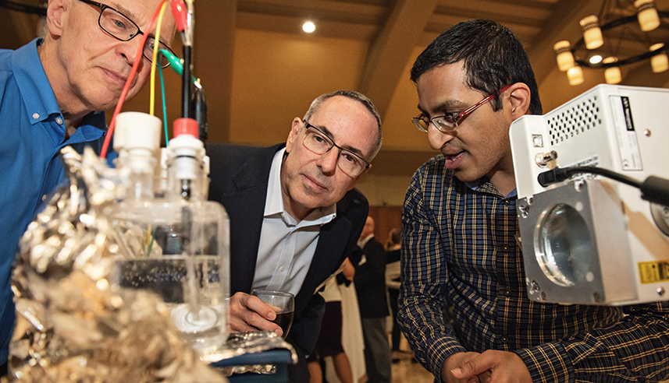
#2 DILIGENCE
Context
Mission: Our mission is to enable adoption. Licenses are not permitted to “shelve” technology.
All Licenses: Diligence milestones are important in ALL licenses (not just exclusive).
Standard Position: : There must be objective milestones that ensure the technology is brought to market.
Point 2
Exclusive licenses should be structured in a manner that encourages technology development and use

Slide 8
DILIGENCE MILESTONES
ARTICLE 5: DILIGENCE MILESTONES
5.1 LICENSEE shall use diligent efforts to develop, secure all applicable government approvals, manufacture, actively market, and fulfill market demand for a full scope of LICENSED PRODUCTS in the TERRITORY, continuously through the term of this Agreement. If the commercialization of multiple LICENSED PRODUCTS is commercially reasonable, then the requirements of this Section shall apply to all such LICENSED PRODUCTS.
5.2 LICENSEE shall achieve the following due diligence milestones for the LICENSED PRODUCTS (together the “MILESTONES”) by the stated dates:
(a)
……
(e)
The requirements of this Section 5.2 are in addition to and do not limit Section 5.1 or any other Section of this Agreement. Each MILESTONE applies only to the first of a series of different LICENSED PRODUCTS, and not with respect to any subsequent LICENSED PRODUCTS. LICENSEE has the right to satisfy its obligations under Section 5.1 and/or Section 5.2 either itself or through the acts of a SUBLICENSEE meeting the obligations of this Agreement.
Common Issues
Milestones: Can take milestones from licensee’s pitch deck. Licensee can suggest dates.
Common Request: Add a “commercial reasonableness” modifier to the specific milestones.
U-M will not agree to this. Need objectivity.
Suggestion: Be precise with language. Milestones often require customized drafting.

Slide 9
DILIGENCE MILESTONES (REMEDIES)
ARTICLE 5: DILIGENCE
****
5.3 LICENSEE shall achieve each MILESTONE on or before the deadline dates indicated. LICENSEE shall provide notice thereof to MICHIGAN within fourteen days after each such deadline as to whether or not such MILESTONE was met. If LICENSEE fails to accurately provide notice to MICHIGAN that it has failed to meet an applicable MILESTONE under this Article by the date of such MILESTONE deadline, LICENSEE shall be deemed to be in material breach of this Agreement. The parties agree that MICHIGAN’s failure to provide notice of breach or initiation of breach proceedings under Article 11 or any other provision of this Agreement shall not operate as a waiver of, or estoppel as to, MICHIGAN’s ability to do so at any time in the future, and any period of limitations that would otherwise apply shall be extended until for a period equal to the period of time from the MILESTONE deadline until the termination of this Agreement.
What Happens?
U-M Position: There must be a mechanism for U-M to retrieve the IP if the licensee is failing to meet reasonable milestones.
Be clear about right to terminate.
Flexibility:
One-time milestone extension fee
Convert to non-exclusive (not preferred)

Slide 10

#3 FUTURE IMPROVEMENTS
Context
Access to Future Work:
Sponsor research (will grant ability to license IP arising from sponsored project)
Relationship with inventor
Avoid Pipeline: Licensee does not have automatic right to future work.
Point 3
Strive to minimize the licensing of “future improvements.”

Slide 11
FUTURE IMPROVEMENTS
Common Issues
Standard Position: Future inventive work should not be encumbered.
Reasonable Fallback: Reasonable to grant option to narrowly defined set of “Improvements.”
Key: Limited to inventions from inventors of licensed IP, which permits inventors to sign-off on this.
DEFINITIONS
1.3 “IMPROVEMENTS” means any modifications, changes, enhancements in and to the LICENSED PRODUCTS or LICENSED PROCESSES, whether patented or not, that: (a) are made by MICHIGAN and disclosed in writing to MICHIGAN’s Innovation Partnerships within three (3) years of the Effective Date; (b) the practice of such would necessarily infringe at least one claim within the PATENT RIGHTS in the FIELD OF USE; (c) was made solely by inventors named on applications or patents within the PATENT RIGHTS; (d) an undivided interest in such invention and related patent rights is owned by MICHIGAN; and (e) are not encumbered by pre-existing obligations of MICHIGAN to any third party in existence prior to the EFFECTIVE DATE.

Slide 12

#4 CONFLICTS OF INTEREST
Context
Research Integrity: Must protect the integrity of the individual’s and institution’s research.
Technology: Must do the right thing for the technology (give technology its best chance to change the world)
Common: Because most of our licenses go to new startups, conflicts of interest are common. This is not a bad thing, so long as the conflict is managed.
Point 4
Universities should anticipate and help to manage technology transfer related conflicts of interest

Slide 13
CONFLICT OF INTEREST MANAGEMENT
Management
Disclosure: Disclose outside interest in publications, presentations, and to students
Ombudsperson: Neutral faculty member for students to approach
Continuing Research: U-M will permit faculty to continue research related to licensed IP.
Deal Approval: All “conflicted” licenses are reviewed by committee and approved by Regents.
ARTICLE 14: CONFLICT OF INTERESTS
14.1 This Agreement and the licenses granted hereunder are subject to approval by a two-thirds majority vote of the Board of Regents of the University of Michigan.
14.2 Unless MICHIGAN provides appropriate formal approvals, continuing development of LICENSED PRODUCTS shall take place without the use of MICHIGAN funds, facilities, or other resources of or funds administered by MICHIGAN.
14.3 LICENSEE shall cooperate with MICHIGAN in developing and implementing appropriate plans for management of potential conflicts of interest and conflicts of commitment of MICHIGAN employees.

Slide 14

#5 BROAD ACCESS
Context
Mission: To maximize positive societal impact – balance broad licensing with need for licensee to invest to bring tech to market.
Variety of Models: Different technologies require different licensing models.
Point 5
Ensure broad access to research tools.

Slide 15
ENSURING BROAD ACCESS: NONEXCLUSIVITY
Nonexclusive v. Exclusive
Last Fiscal Year:
240 nonexclusive licenses
43 exclusive licenses
When Exclusivity Works: When the amount of investment required to bring the product to market requires exclusivity.
ARTICLE 2: GRANT OF RIGHTS
2.1 MICHIGAN hereby grants to LICENSEE a nonexclusive license under the PATENT RIGHTS, subject to the terms and conditions of this Agreement, in the FIELD OF USE and the TERRITORY to make, have made, import, use, market, offer for sale and sell LICENSED PRODUCTS.

Slide 16
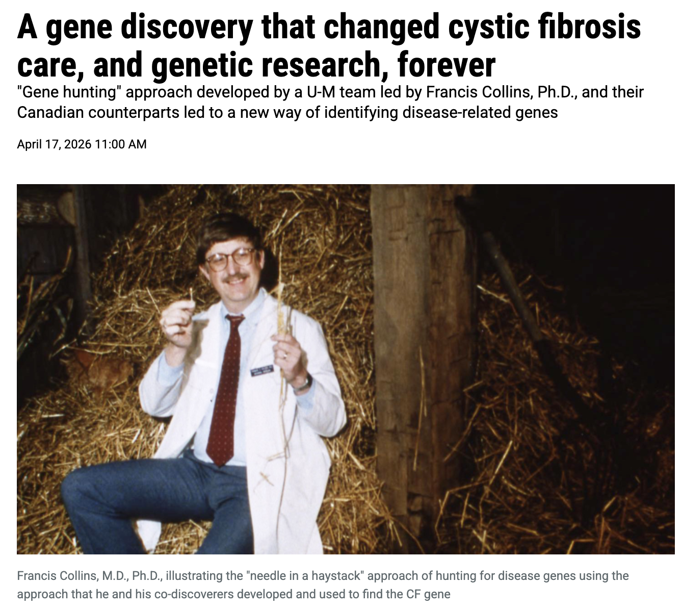
ENSURING BROAD ACCESS: EXAMPLE
CF Gene Patent Licensing
Nonexclusive: Nonexclusive licensing employed to enable broad access
Fees: Reasonable fee structure to allow in-house diagnostics
Inventor Input: Significant input from inventor assisted in strategy
NGOs: Partnered with OneWorldHealth to enable humanitarian licensing

Slide 17
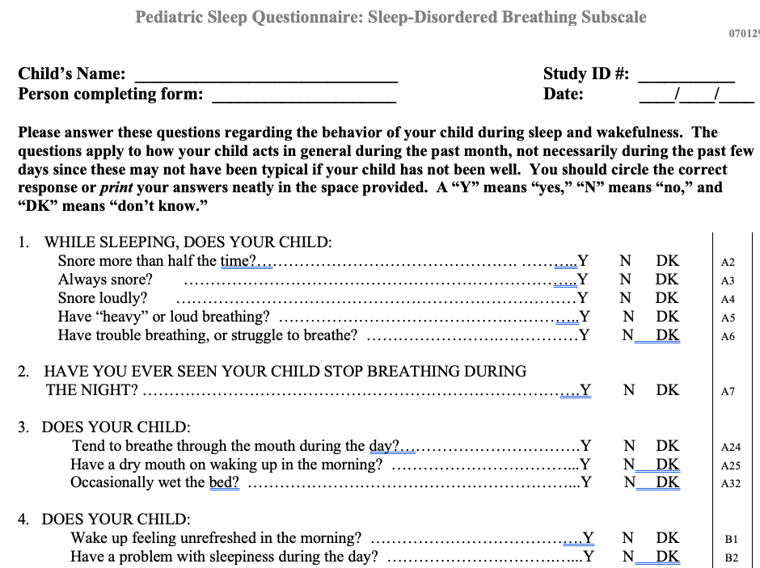
ENSURING BROAD ACCESS: EULAS
Patient Reported Outcomes
END USER LICENSE AGREEMENT
I. LICENSE
MICHIGAN hereby grants to LICENSEE a non-exclusive, non-transferable right to use the PROGRAM solely within the department or business unit listed above and subject to the terms and conditions of this Agreement.
II. LIMITATION OF LICENSE AND RESTRICTIONS
A. LICENSEE is granted the right to use the PROGRAM in a clinical trial and research studies under LICENSEE program support for the “Validation of Patient Reported Outcome Measures (PROMs) tools in Inherited Retinal Dystrophies (IRD)”, Research Ethics Board Number 1000062319. The license allows for use with unlimited unique participants in the research protocol above (collectively referred toas “STUDY”). In connection with the STUDY, MICHIGAN hereby authorizes LICENSEE to modify and translate the PROGRAM as set forth in Exhibit A attached hereto. The PROGRAM shall be distributed by the department or business unit listed above or such department or business unit’s designee to the participants enrolled in the STUDY at appropriate intervals during the term of this Agreement.
>1.5M patients
given a voice through UM patient reported outcomes” (last 10 yrs.)
30+ active patient reported outcomes
across multiple domains at UM

Slide 18
ENSURING BROAD ACCESS: DUAL TRACK
Free Academic
License
DIGITAL RESEARCH TOOL
60-day
Trial
Paid Commercial
License

Slide 19
ENSURING BROAD ACCESS: FIELDS OF USE
Unpursued Fields of Use
Common Issue
University technologies often have multiple potential applications
Licensees initially want access to all fields of use
Universities want to ensure that any potential field of use can be pursued
Compromise: Allows licensee to raise money & explore all fields of use; preserves ability to address a field of use when a viable third party is interested
ARTICLE 6: SUBLICENSES
6.5 If at any point after the second anniversary of the EFFECTIVE DATE, a third party (“Interested Third Party”) notifies MICHIGAN of LICENSEE of its bona fide interest in commercializing LICENSED PRODUCTS in a field of use for which LICENSEE or a SUBLICENSEE is not then developing or selling LICENSED PRODUCTS (“New Field of Use”), MICHIGAN may provide written notice to LICENSEE specifically identifying such New Field of Use (“Interested Third Party Notice”). Within sixty (60) days after such notice from MICHIGAN, LICENSEE shall provide written notice to MICHIGAN (“New Field of Use Election”), containing one of: (a) LICENSEE’s written statement and documented evidence of its commercially reasonable efforts to develop a LICENSED PRODUCT for commercial use in the New Field of Use (to be reviewed and verified by MICHIGAN in its reasonable discretion); (b) LICENSEE’s election to amend the “FIELD OF USE” definition hereunder to exclude the New Field of Use, to be negotiated in good faith by the Parties and documented within thirty (30) after the New Field of Use Election; (c) LICENSEE’s election to negotiate in good faith with the Interested Third Party for an exclusive sublicense in the New Field of Use under commercially reasonable terms (to be completed within three (3) months after the New Field of Use Election); or (d) LICENSEE’s election to enter into negotiations with MICHIGAN to amend the Agreement to include specific diligence terms specifically addressing and requiring the prompt development of LICENSED PRODUCTS in the New Field of Use (said amendment to be completed within three (3) months after the New Field of Use Election). If the particular election in LICENSEE’s New Field of Use election is not accepted (in the case of election (a)) or completed in the time period specified above despite the good faith efforts of MICHIGAN, then upon MICHIGAN’S ten (10) day written notice to LICENSEE, the “FIELD OF USE” definition hereunder shall be automatically amended to exclude the New Field of Use.

Slide 20
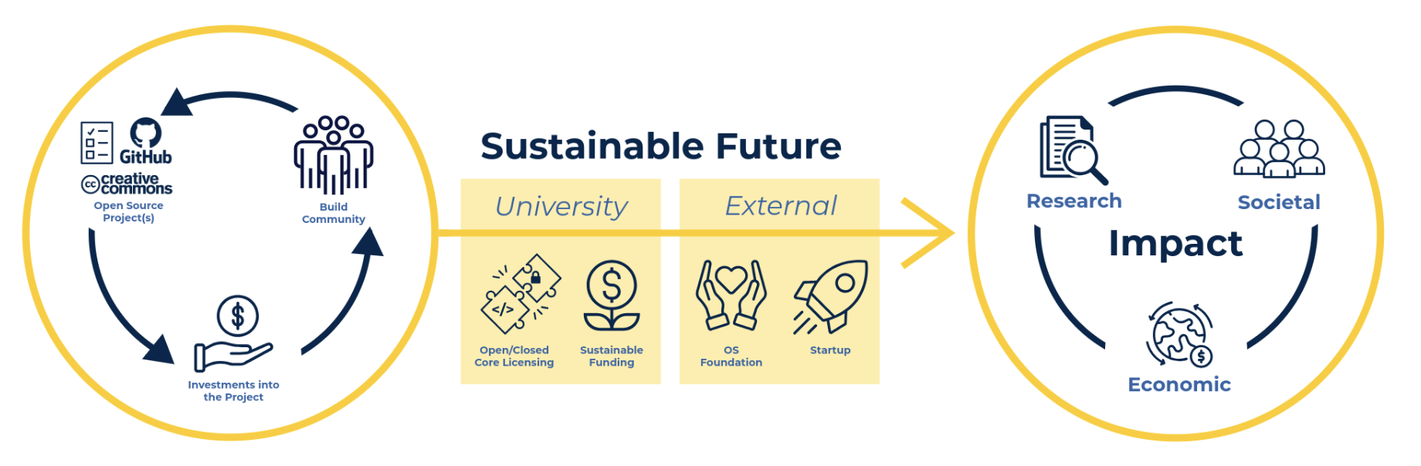
OPEN SOURCE LICENSING SUPPORT

Slide 21
#6 ENFORCEMENT
Context
Rare Situations: Litigation for academic innovations is extremely rare
Controls: Helpful to impose reasonable controls on licensee’s ability to enforce.
Point 6
Enforcement action should be carefully considered.

Slide 22
ENFORCEMENT
Enforcement Controls
Delayed Right: Technology must have reached the market or clinical trials.
Investigation: Licensee must perform thorough investigation.
Notice: License must notice U-M 20 days in advance.
Balance: Balancing licensee’s need to protect its investment with preventing reckless enforcement that stifles innovation.
ARTICLE 8: ENFORCEMENT
8.1 Each party shall promptly advise the other in writing of any known acts of potential infringement of the PATENT RIGHTS by another party. [After the earlier of (a) the FIRST COMMERCIAL SALE or (b) LICENSEE makes any required Investigational Device Exemption or Investigational New Drug Application (or equivalent) filing with the Food and Drug Administration, LICENSEE has the first option to enforce the PATENT RIGHTS against infringement by other parties within the TERRITORY and the FIELD OF USE, including those prior to the EFFECTIVE DATE. LICENSEE shall not file any suit without (a) first performing a thorough, diligent investigation of the merits of such suit, including with respect to the validity and enforceability of the PATENT RIGHTS; (b) there being reasonable legal and economic bases for doing so; and (c) notifying MICHIGAN twenty days before any such filing. This right to enforce includes filing, prosecuting, and settling all infringement actions at its expense, except that LICENSEE shall make any such settlement only with the advice and consent of MICHIGAN. LICENSEE has the right to file suit using counsel of its choosing, subject to MICHIGAN’s approval, which shall not be unreasonably withheld or delayed. LICENSEE may grant to third parties the right to enforce hereunder, but only with the express written permission of MICHIGAN.
8.2 If LICENSEE has complied with Paragraph 8.1, MICHIGAN shall provide reasonable assistance to LICENSEE with respect to such actions, but only if LICENSEE promptly reimburses MICHIGAN for out-of-pocket expenses incurred in connection with any such assistance rendered at LICENSEE'S request or reasonably required by MICHIGAN, including but not limited to expenses incurred in complying with discovery duties. LICENSEE shall defend, indemnify and hold harmless MICHIGAN with respect to any claims asserted by an alleged infringer reasonably related to the enforcement of the PATENT RIGHTS under this Article, including but not limited to antitrust counterclaims and claims for recovery of attorney fees.

Slide 23
#7 KNOW-HOW LICENSING
Licensing Know-How
Hot Issue: Increased interest in know-how licensing:
licensees seeking freedom to operate under all forms of IP
increased importance of data and other unpatentable information (e.g., drug targets).
University Sensitivity:
Academic freedom(can’t stop faculty from sharing/presenting)
Importance of publishing
Export controls
Point 7
Be mindful of export regulations.

Slide 24
KNOW-HOW LICENSING
Know-How Licensing
Nonexclusive: U-M will only license know how on a nonexclusive basis.
No Future Requirement: Know-how limited to information already provided; there is no obligation to provide future Know-How.
Export Controls: Export control screening for any Know-How transfers.
DEFINITIONS
“KNOW-HOW” means MICHIGAN’s rights in discoveries, information, trade secrets, knowledge, technology, means, methods, processes, practices, formulae, instructions, skills, techniques, procedures, experiences, ideas, technical assistance, designs, drawings, assembly procedures, computer programs, apparatuses, specifications, results, assays, materials, data and information (“Materials”), generated by or under the supervision of Drs. _____ and ____ or MICHIGAN Personnel under their supervision that MICHIGAN owns, has under license, or otherwise controls, whether or not confidential, proprietary, patented or patentable, provided that the Materials both: (i) are necessary or reasonably useful for LICENSEE to exploit related to the LICENSED TECHNOLOGY; and (ii) are (in written, electronic or any other tangible form) actually delivered to LICENSEE within sixty (60) days of the effective date of the applicable license.
ARTICLE 1: GRANT OF RIGHTS
MICHIGAN hereby grants to LICENSEE a royalty-free non-exclusive license to KNOW-HOW, subject to the terms and conditions of this Agreement, in the FIELD OF USE and the TERRITORY to develop, have developed, manufacture, have manufactured, use have used, import, have imported, distribute, sell, offer for sale, and have sold LICENSED TECHNOLOGY.

Slide 25
#8 PARTNER SELECTION
Important
License Qualification: U-M invests significant resources in qualifying potential partners.
Point 8
Be mindful of the implications of working with patent aggregators.

Slide 26
PARTNER SELECTION
Partners
Inventor - Licensee: Licensee’s relationship with inventor is major criteria in licensee selection and success.
Option Periods: Can be useful period of two-way due diligence.
Qualifications: Success is always uncertain, so diligence milestones are essential.
PATENT OPTION AGREEMENT
4.3 EXERCISE OF OPTION. OPTIONEE may exercise the OPTION by providing a business plan to MICHIGAN describing OPTIONEE’s intention and ability to develop and make commercially available LICENSED PRODUCTS within the FIELD OF USE for public use as soon as practicable, consistent with sound and reasonable business practices and judgment. At a minimum, the business plan shall include:
i. an identified and committed experienced and capable management team,
ii. an appropriate commercialization strategy, and
iii. a capitalization plan indicating sufficient access to capital to enable the commercialization plan to be executed.
The acceptance of the OPTIONEE business plan shall be at MICHIGAN’s sole discretion. Notwithstanding, OPTIONEE may not exercise its option at any time any litigation or administrative proceeding is pending in which OPTIONEE has asserted the invalidity or unenforceability of any claim in the PATENT RIGHTS, either directly or through any other party.

Slide 27

#9 UNMET NEEDS
Approaches
Reserved Right: Broad right, but only applies to licensed patents
Compulsory Sublicensing: Typically only applies to licensed patents
Affordable Access Plans: Modern approach pioneered by UCLA and Medicines Patent Pool
Point 9
Consider including provisions that address unmet needs, such as those of neglected patient populations or geographic areas, giving particular attention to improved therapeutics, diagnostics and agricultural technologies for the developing world.

Slide 28
AFFORDABLE ACCESS PLANS
4.7 LICENSEE shall provide to MICHIGAN an Affordable Access Plan of the scope set forth in this Section 4.7 within three (3) months after the first marketing approval of a LICENSED PRODUCT received by LICENSEE or a SUBLICENSEE from the U.S. Food and Drug Administration or the European Medicines Agency. LICENSEE agrees to use reasonable efforts to make progress toward completing the plans stated in the Affordable Access Plan, as it may be amended from time-to-time.
(a) “Affordable Access Plan” means a written statement setting forth: (a) the specific LMICs in which neither LICENSEE nor any SUBLICENSEE intends to commercialize the LICENSED PRODUCTS (the “Non-Commercialized Territories”); (b) actions to be taken by LICENSEE and, if applicable, SUBLICENSEE(s) that reasonably intended to support affordable access in the Non-Commercialized Territories by patients to products that would constitute LICENSED PRODUCTS if covered by one or more of the PATENT RIGHTS; and (c) actions to be taken by LICENSEE and, if applicable, SUBLICENSEE(s) that are reasonably intended to support affordable access for the vulnerable, underserved and special needs populations in the U.S. Such actions, as referred to above, shall at a minimum include strategies, such as licensing or partnerships (which may include, for example, partnerships with non-profit organizations), and timelines therefor. As used herein, “LMICs” means Low and Middle Income Countries as the term is defined and/or used by the World Bank Group, its primary recognized member organizations, and/or successor of any of the foregoing. Upon LICENSEE’s request, MICHIGAN agrees to meet with LICENSEE to assist in the drafting of the Affordable Access Plan.
(b) Notwithstanding the foregoing, in lieu of providing an Affordable Access Plan, LICENSEE may instead submit a reasonably detailed written explanation as to why LICENSEE believes that an Affordable Access Plan is unreasonable or infeasible (the “Infeasibility Statement”), which is due on the same date that the Affordable Access Plan would have been due. After LICENSEE submits an Infeasibility Statement to MICHIGAN, LICENSEE agrees to promptly (but in no event less than two months thereafter) meet with MICHIGAN in person or by video conference to discuss the Infeasibility Statement (the “Initial Discussion”). If, following such meeting, MICHIGAN concludes that the Affordable Access Plan requirements of this Agreement are reasonable and desirable, LICENSEE shall nevertheless provide an Affordable Access Plan to MICHIGAN within three (3) months after MICHIGAN’S written request following the Initial Discussion (and, for clarity, the remaining provisions relating to the Affordable Access Plan shall apply).
(c) If LICENSEE fails to follow any plan, take any action, or meet any milestone by a deadline that is specifically or generally stated in the Affordable Access Plan, it shall promptly and in good faith negotiate an amended Affordable Access Plan with MICHIGAN. In addition, within thirty (30) days after a request by MICHIGAN (but not to be requested any more than once in any calendar year), LICENSEE agrees to confer with MICHIGAN in good faith to review LICENSEE’s progress, and to consider in good faith any reasonable modifications suggested by MICHIGAN concerning LICENSEE’s Affordable Access Plan (“Progress Discussion”). MICHIGAN may invite a designated entity to join either the Initial Discussion or Progress Discussion, provided that such discussions shall at all times be made subject to the confidentiality obligations of this Agreement (or another mutually agreed-upon nondisclosure agreement).
AAP Implementation
After Approval, Licensee Discloses:
LMICs not being pursued
Actions to pursue LMICs
Why This Works:
Information sharing
77% of pharma uses Access Plans
Applies to the drug (not the patent)
Adoption:
UM’s last 12 exclusive therapeutics licenses
8 funding rounds (>$100M raised)

Slide 29

BONUS: SUPPORT SOCIAL IMPACT REGARDLESS OF ROI
Social Impact Toolkit
Stay or Go: Support existing university centers in assessing the economics of spinning out.
Entity Selection: Develop expertise around entity selection criteria for social enterprises.
Fiscal Sponsors: Identify potential fiscal sponsors
U-M PRINCIPLE
Support nonprofits and other social impact ventures regardless of the likelihood of licensing revenue providing a meaningful ROI.

Slide 30

U-M SOCIAL IMPACT ACCELERATOR
Example Projects
TRAILS: Mental health counseling materials for high schools
Open Source Leg Project: End-to-end open-source platform providing researchers with standardized hardware designs, software libraries, and documentation to ease development
Skiff & Schooners: Interdisciplinary, grant-funded initiative that partners with regional organizations to reconnect communities with the river and its stories
New Nonprofit
IP License
501(c)(3) Nonprofit
“Social Impact Accelerator”
IP License
New Nonprofit
IP License
New Nonprofit

Slide 31
Thank you!
Questions?

